Slide 1
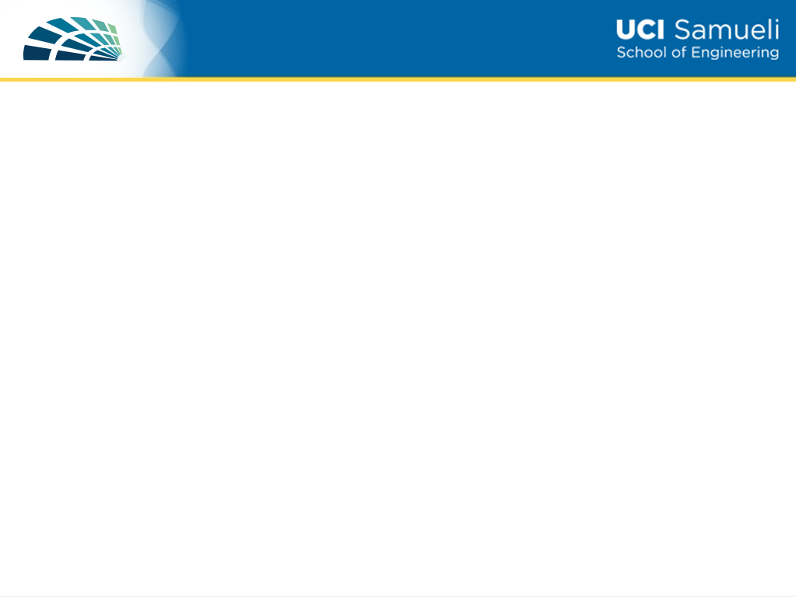
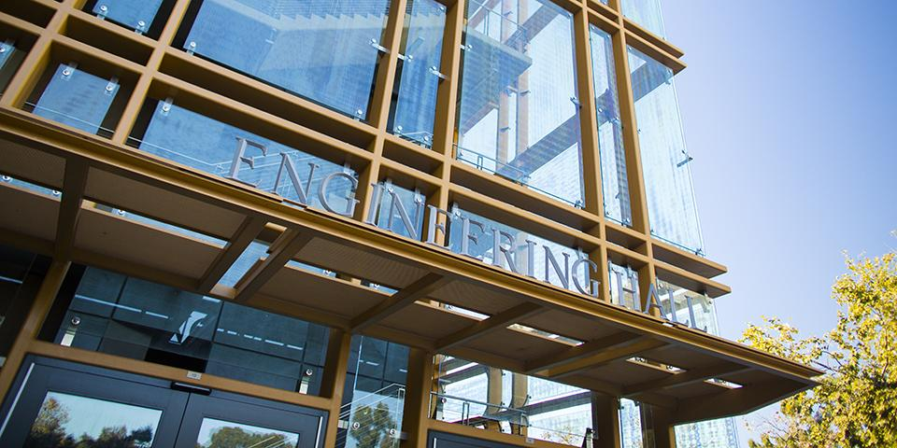

Notes:
Hello and welcome to the Henry Samueli School of Engineering Information presentation. First and foremost, we’d like to offer our congratulations on your admission! In the following presentation, we hope to answer some of the questions you may have about our program at UC Irvine. In the next slide, please enjoy a message from Associate Dean Mike Green.

Slide 2
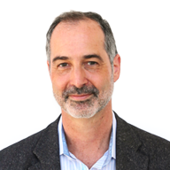
A Message From Assoc. Dean Green
Dear prospective student,
Welcome to our virtual Celebrate UCI presentation, and most importantly congratulations! This year the Samueli School of Engineering received over 12,500 freshman applications. Because of the large number of applications, we had to be very selective in our admissions.
No doubt many of you have a number of options for your higher education. If you have already decided to come to UCI, I hope that this presentation will make you even more sure that you’ve made the right choice. If you’re still considering UCI among other options, I hope that this presentation will show you that UCI is a special place, which will help you decide.
For parents & other family members, I know this is a major transition for you as well. I hope this presentation will convince you that you can trust UCI as a place where we care deeply about undergraduate education.
Enjoy the presentation, and we hope to see you this fall as our newest Anteaters!
Notes:
A message from Associate Dean Mike Green who is also a professor in the Electrical Engineering and Computer Science Department.

Slide 3
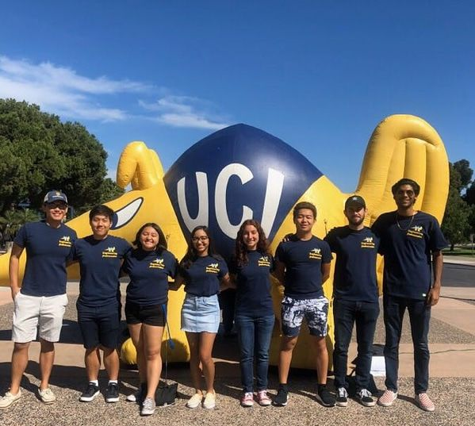
WHY ENGINEERING AT UCI?
Notes:
There are a number of reasons why the Engineering program at UCI is a great choice! We will highlight several of those reasons in this presentation.
Pictured here are some of our Engineering Ambassadors! They are available to answer questions about life at UCI as an Engineering major!

Slide 4
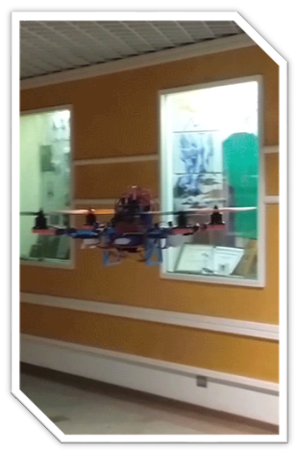
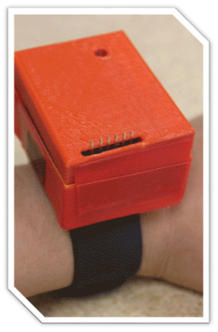
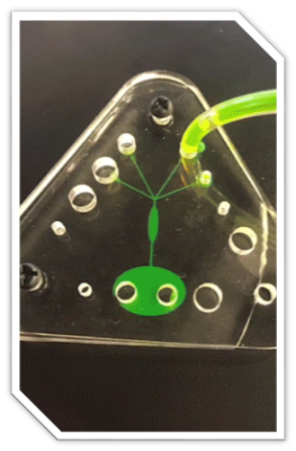
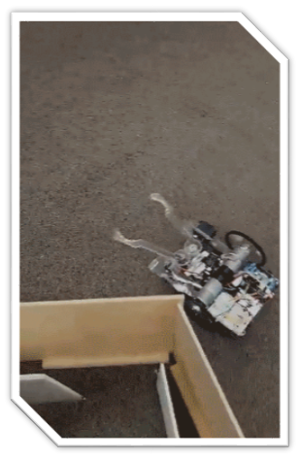
Engineering 7A/B: Freshman Design
Autonomous Payload Fitness Tracker Lab-on-a-chip Autonomous Rover
Delivery/Mapping Concentration detector
Notes:
The number 1 reason we think you should choose engineering at UCI is our Introduction to Engineering course offered for our first year students! This is a 2-quarter course that allows students to gain hands-on experience from the very beginning of their curriculum. In this course, students will conceive, design, build and test a project each quarter. Some examples are quadcopters, fitness trackers, autonomous rover and lab-on-a-chip. This course is multi-disciplinary and team-based.

Slide 5
TEACHING APPROACH
Large lower division classes
Upper division courses smaller and more interactive
  Year-long senior design courses
  Projects – cargo airplane, steel bridge, rocket, Hyperxite
Interaction with faculty is hallmark of smaller classes
Blend of fundamentals, research and hands-on
Classes are taught by world class faculty
Notes:
Though students will begin their program taking large lower division courses, as they move through the program, class size will become smaller allowing for a much more interactive environment. Our program blends fundamentals with research and hands-on experience. More importantly, our classes are taught by world-class faculty. The following slides will highlight some of those faculty.

Slide 6
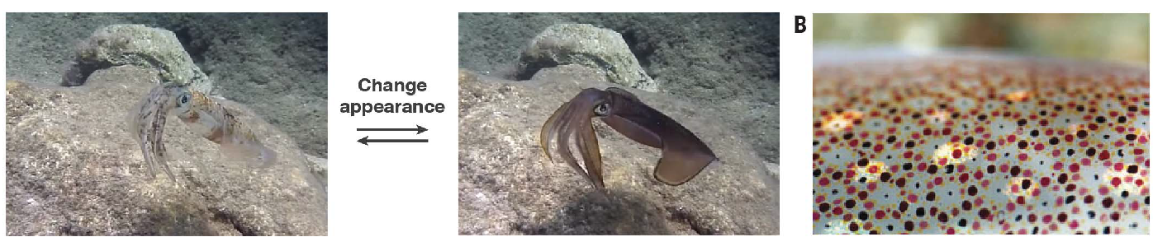
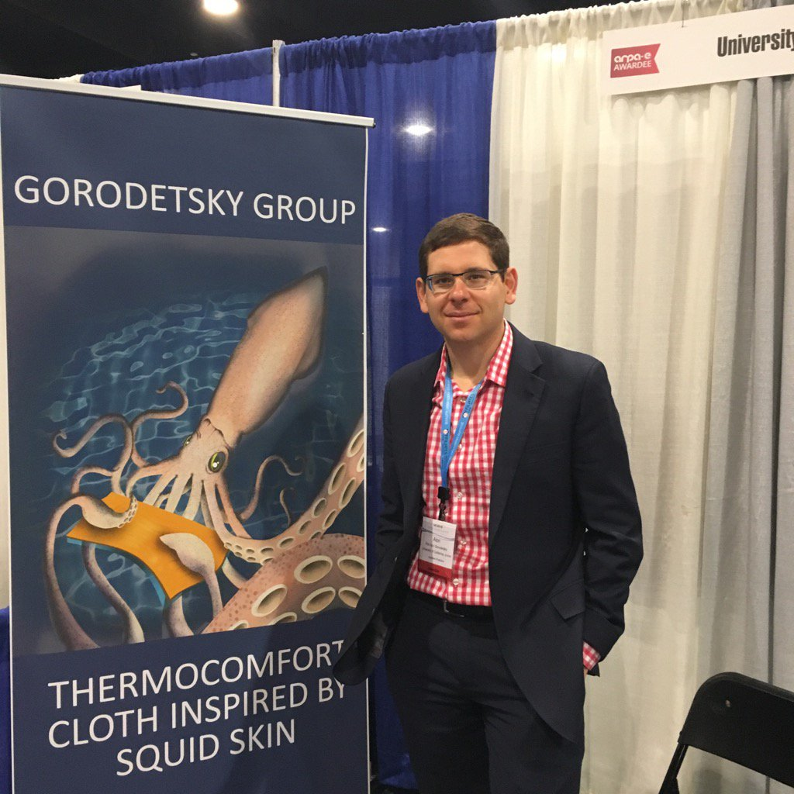
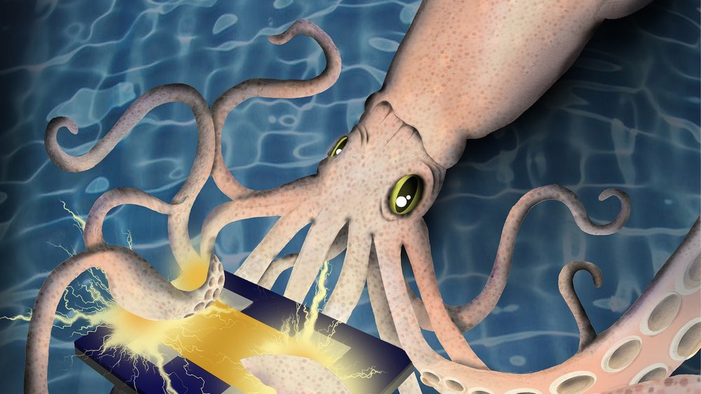
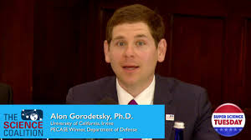
World-Class Faculty
Prof. Alon Gorodetsky (Dept. of CBE)
Notes:
Prof. Gorodetsky, a prof in Chemical and biomolecular engineering, has unlocked the secret of how squid spontaneously change their colors. Because of this, he was recently invited to serve as subject-matter expert by the National Academies of Sciences, Engineering and Medicine for a workshop on the potential military applications of bio-inspired materials.

Slide 7


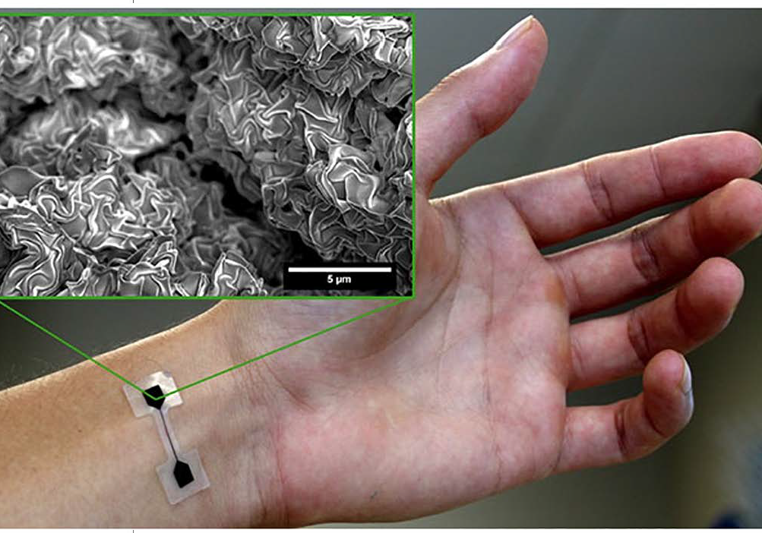
World-Class Faculty
Prof. Michelle Khine (Dept. of BME)
Notes:
A professor in BME, Dr. Khine’s inventions allow vital signs to be communicated instantly to mobile devices via the Internet of Things.

Slide 8
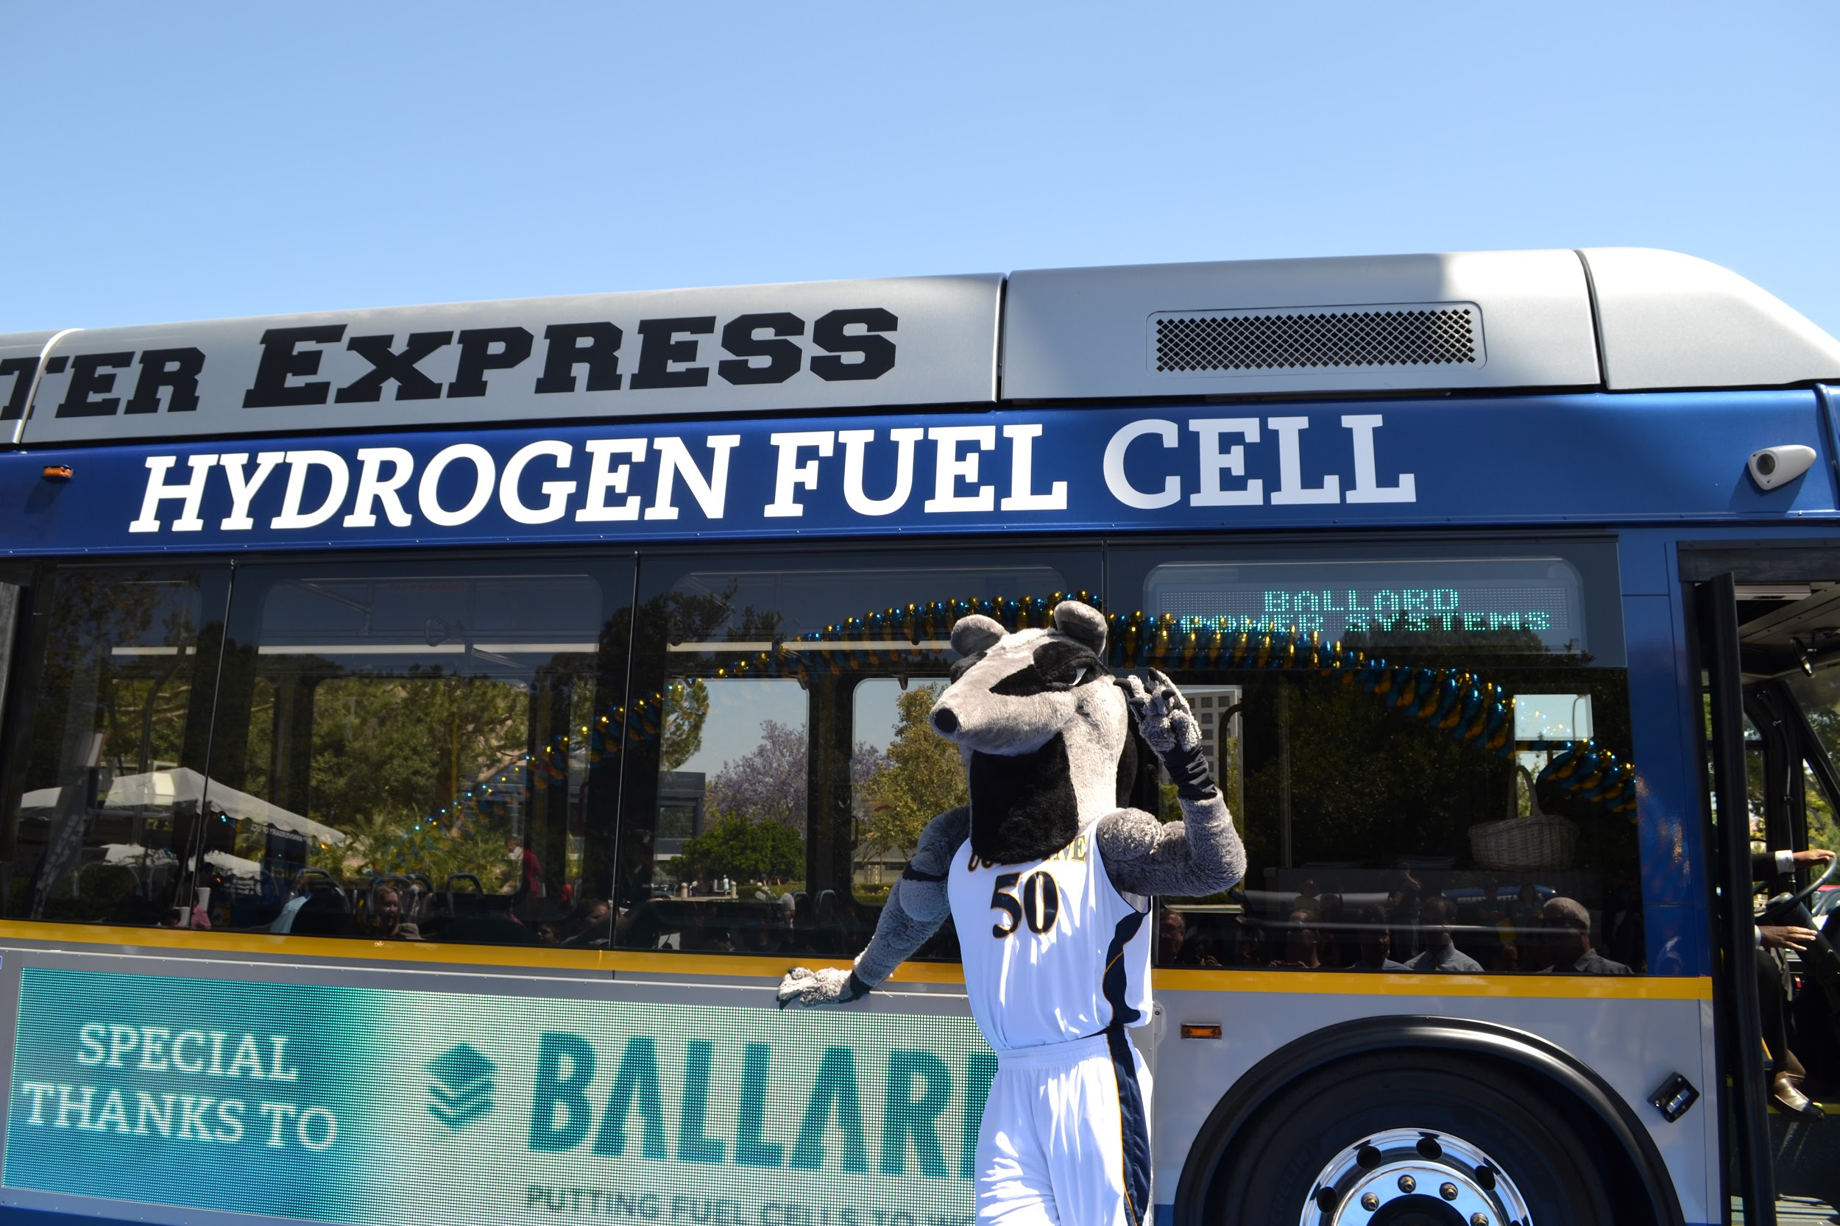
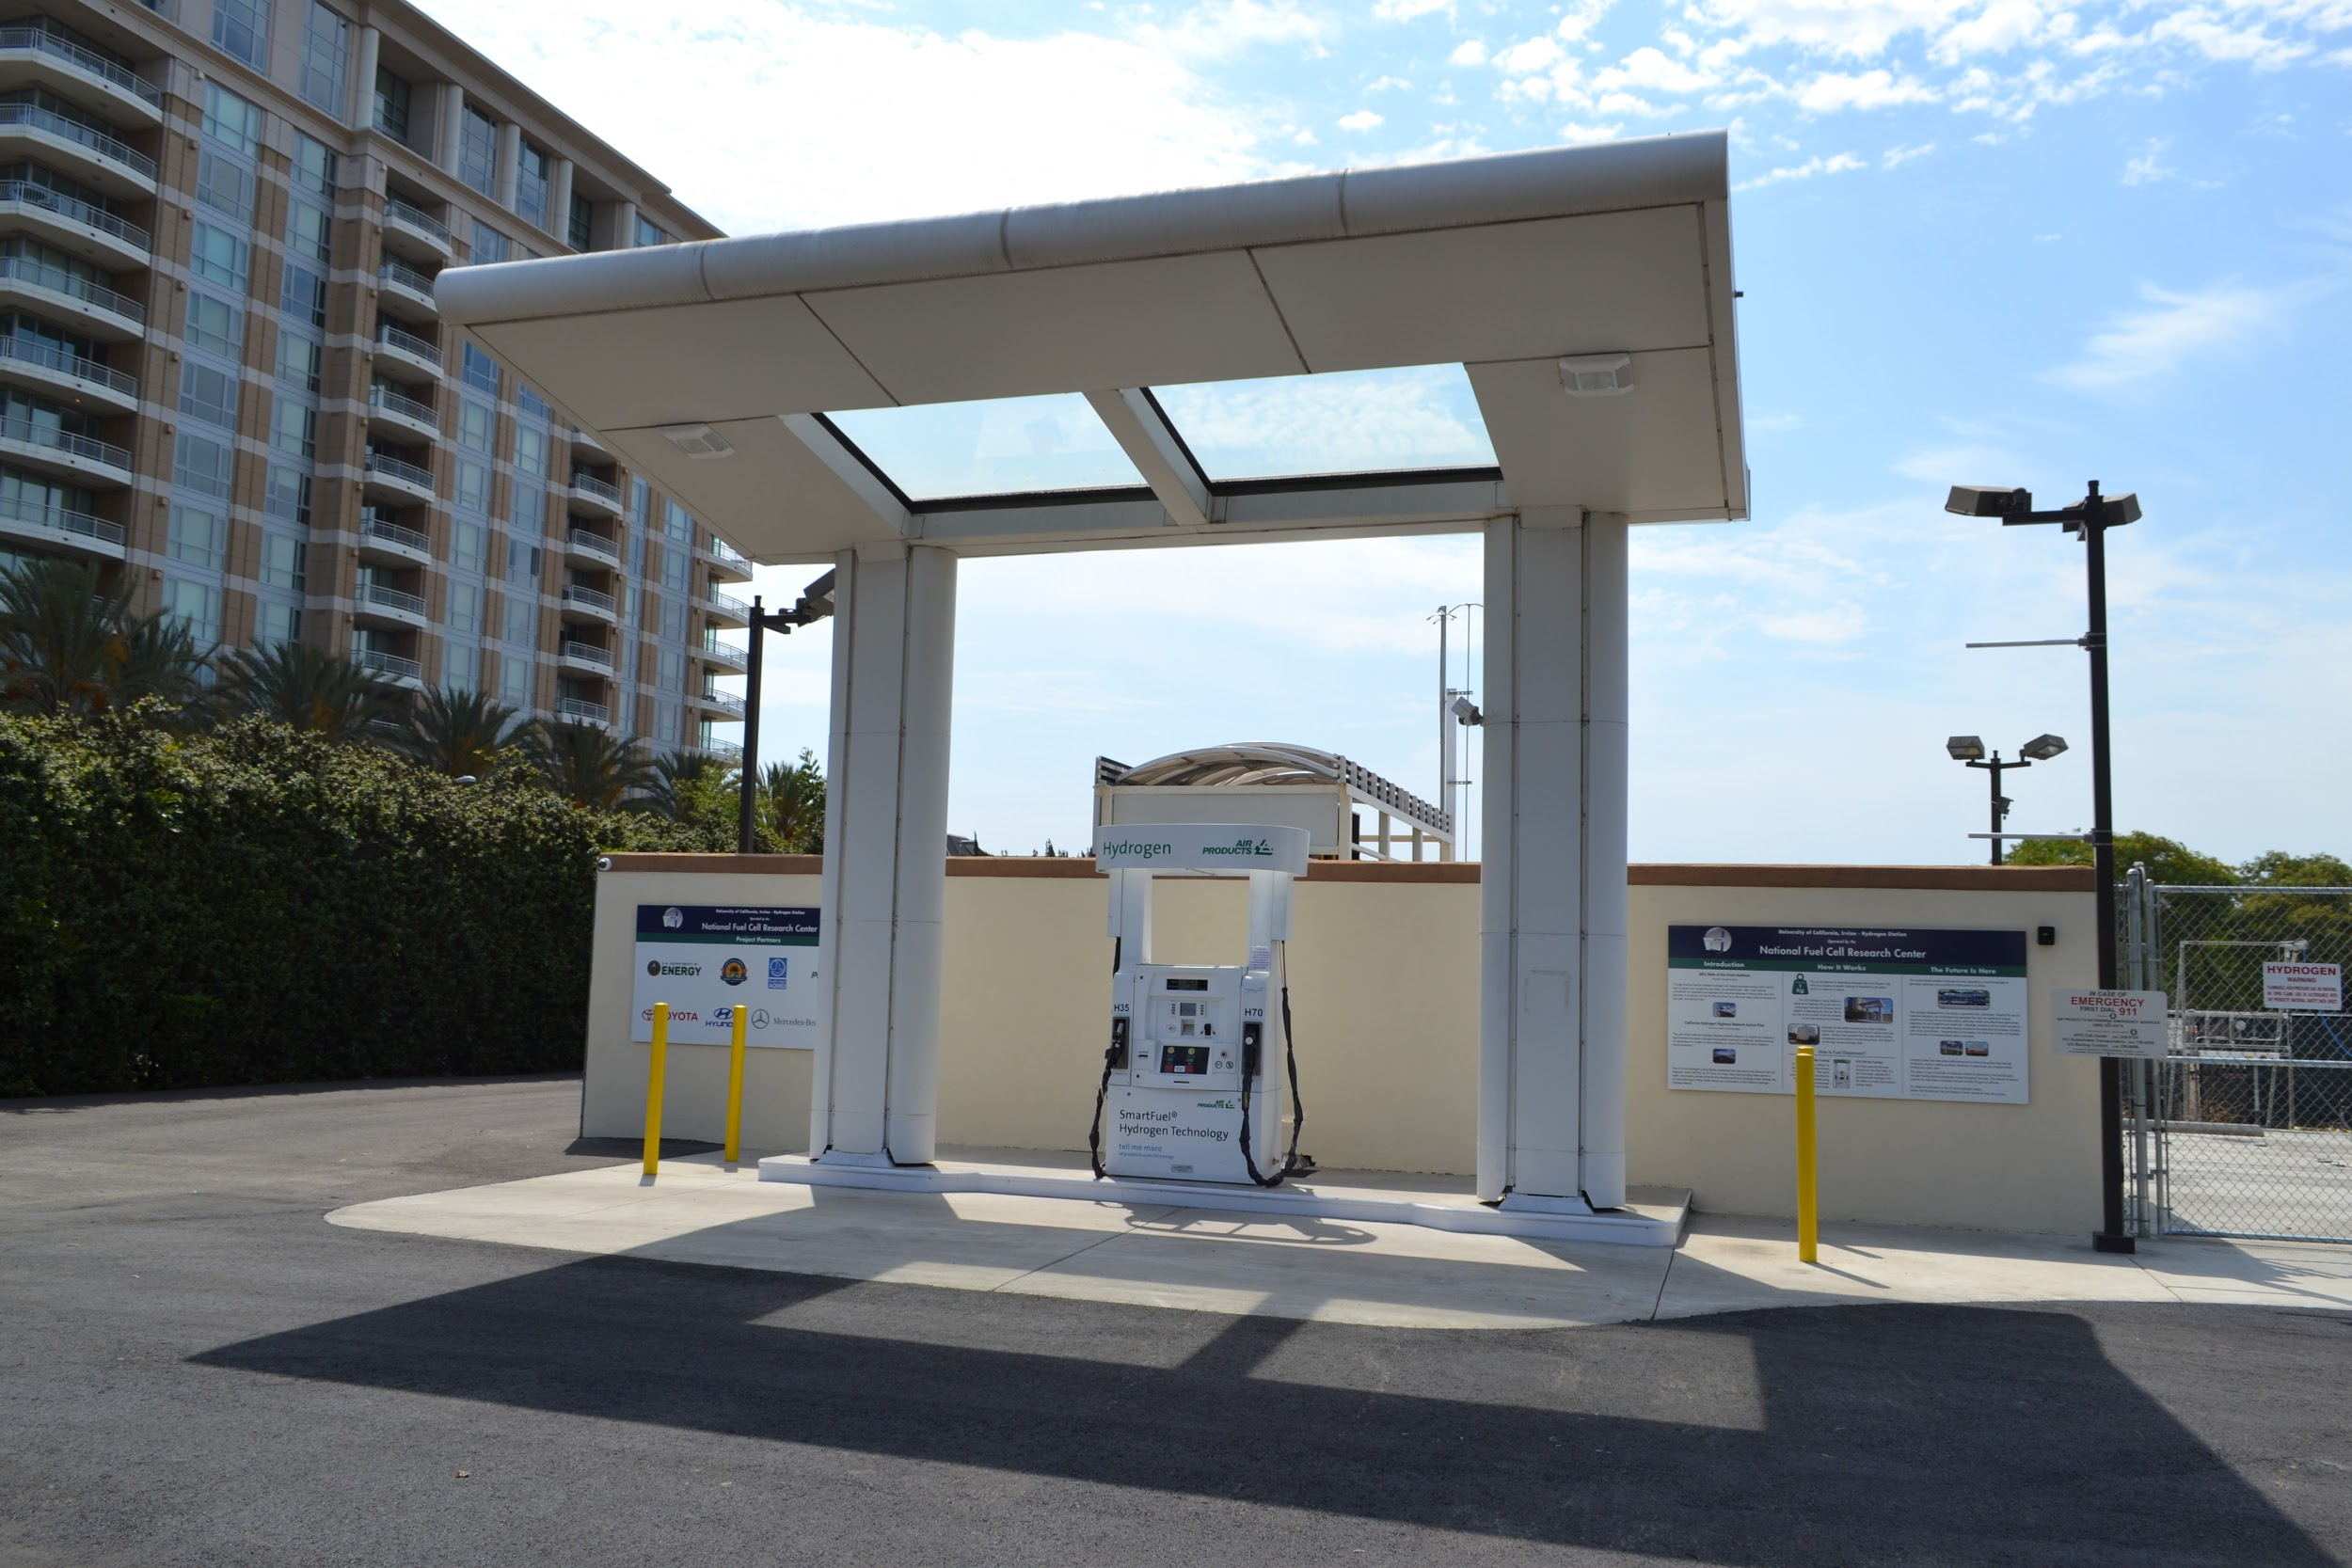

World-Class Faculty
Prof. Scott Samuelsen (Dept. of MAE)
Notes:
Our transportation and energy has traditionally relied on combustion of fossil fuels for over a century. The vision of replacing that technology with cleaner non-combustible alternatives, such hydrogen fuel cells, is being realized thanks to Professor Samuelsen’s ground-breaking research.
Through his ground-breaking research, Dr. Samuelsen, a prof in MAE, the vision of replacing fossil fuels with cleaner, non-combustible alternatives, such as hydrogen fuel cells, is being realized.

Slide 9
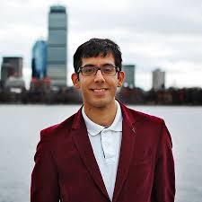
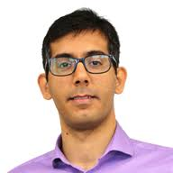
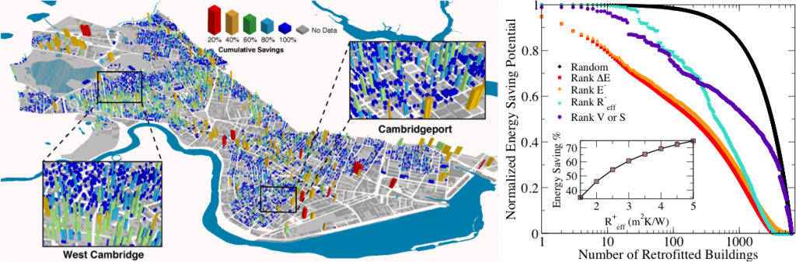
World-Class Faculty
Prof. MJ Qomi (Dept. of CEE)
Notes:
Professor Qomi is investigating fundamental physical properties of construction materials to drastically reduce energy costs and consumption in buildings.
Prof Qomi, in our CEE department, is investigating the fundamental physical properties of construction materials to drastically reduce energy cost and consumption.

Slide 10
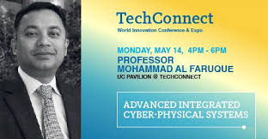
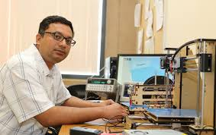
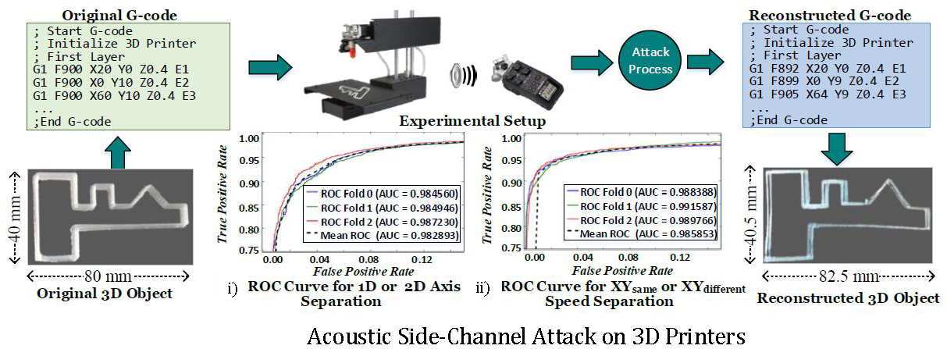
World-Class Faculty
Prof. Mohammad Al-Faruque (Dept. of EECS)
Notes:
Prof. Al-Faruque has discovered a hack in which the sounds emanating from a 3D printer can be captured and analyzed by a nearby mobile device, allowing theft of proprietary manufactured devices. Based on this discovery, he is working on improving cybersecurity.
Prof. Al Faruque, who has a joint apt with both Electrical Engineering and Computer Science and MAE, is working on improving cybersecurity

Slide 11
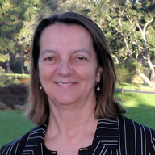
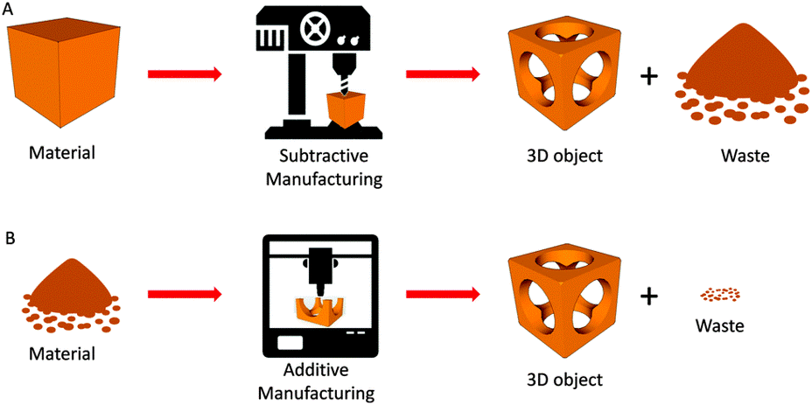
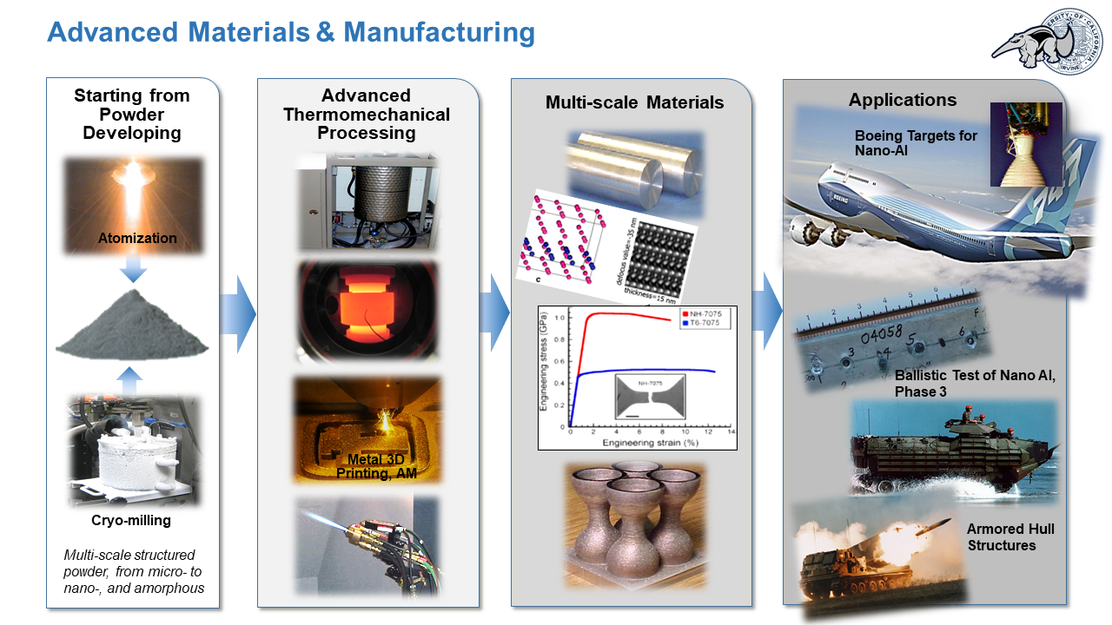
World-Class Faculty
Prof. Julie M. Schoenung (Dept. of Materials Science and Engineering)
Notes:
Prof Shoenung, dept chair for our newly formed Materials Science and engineering department, is researching the synthesis and characterization of advanced materials. She also focuses on Green engineering and pollution prevention.

Slide 12
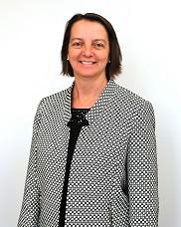
Notes:
All of these faculty members bring in undergraduate researchers to assist in their labs every quarter! UROP program has a proposal program that provides funding to UG researchers.

Slide 13
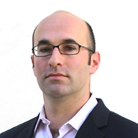
A Message From Prof. Allon Hochbaum
Materials Science and Engineering (MSE) at UCI is a long-standing undergraduate major and newly formed department looking for creative and motivated undergraduate students. The discipline covers many aspect of materials discovery, design, characterization, processing and implementation in applied areas. Materials scientists and engineers contribute to industry and academic work in a wide range of areas, from next-generation solar panels, battery and fuel cell materials, to innovative biomedical devices and implants, new electronics and display technologies, and lightweight and uniquely strong materials for automotive, terrestrial and space flight systems. The MSE curriculum is a blend of physics, chemistry and math applied to materials problems. If you're interested in understanding how these materials work, how to design new materials that work better, and how to make and apply them in future technologies, please get in touch with MSE Undergraduate Advisor, Prof. Allon Hochbaum (hochbaum@uci.edu) for more information about an MSE major or minor degree at UCI.
Notes:
Here, Undergraduate Program Advisor Professor Hochbaum discusses the exciting new Materials Science and Engineering department.
Our newest department is Materials Science and Engineering. Here you’ll see a message from Undergraduate Program Advisor PROF. HOCHBAUM describing some of the exciting things about the MSE major!

Slide 14
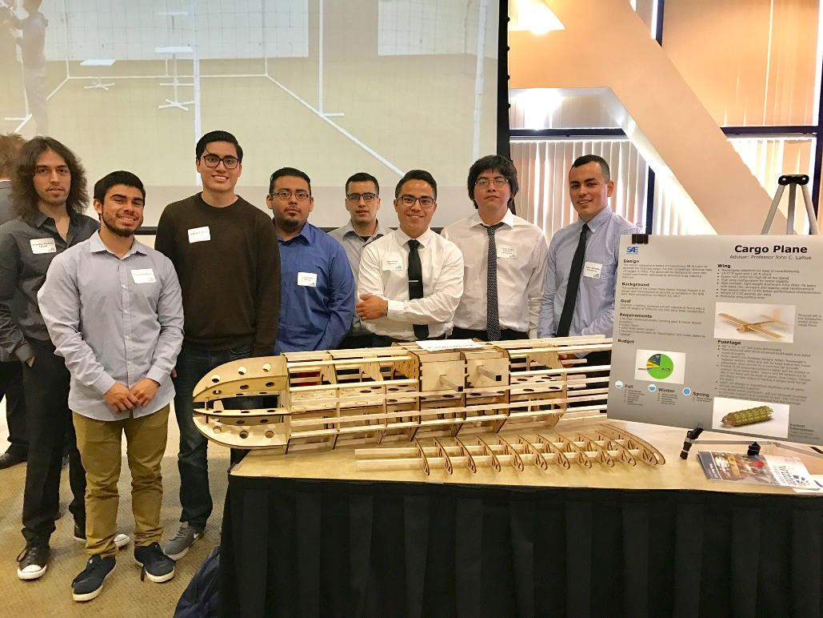
PRACTICAL DESIGN OPPORTUNITIES
SENIOR DESIGN PROJECTS
  Autonomous parking vehicle
  Robotics
  Microfluidics
ENGINEERING DESIGN COMPETITIONS
  Steel bridge
  HyperXite
  Cargo plane
  Race Car
Notes:
Another highlight of our program is the many practical design opportunities available for our students. Most of our majors will complete a capstone project in their senior year. This may be a quarter long project or may be a full year.
Students can also take advantage of the many design competitions including steel bridge, HyperXite, Cargo plane, rocket project and race car. These projects are multi-disciplinary and are used to compete both nationally and internationally.

Slide 15
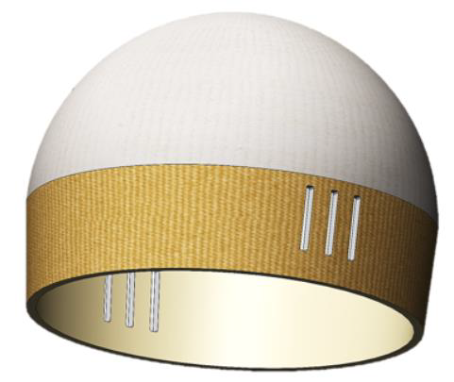
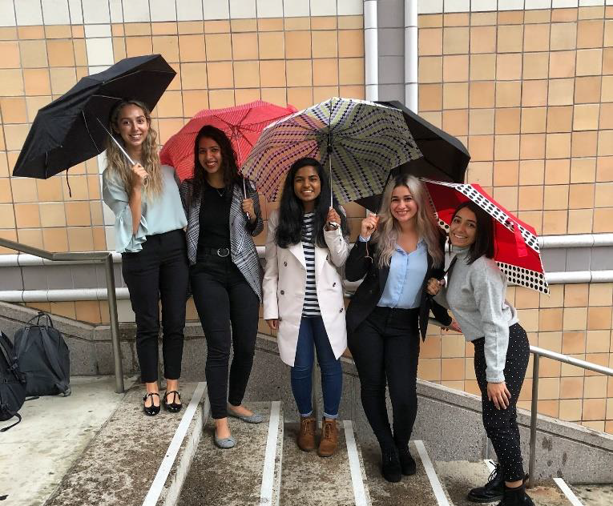
Biomedical Engineering- The BiliBeanie
Designed a phototherapy mask that will protect a neonate’s eyes while still allowing the phototherapy light to penetrate through and help treat jaundice.
Collaborated with mentors from the Children’s Hospital of Orange County and the Innovation Lab in Newport Beach to develop the phototherapy mask and ensure that we can manufacture a safe and effective device for usage in hospitals.
The COVID-19 pandemic also created a materials shortage that resulted in our team pivoting our project to develop medical face masks.
Using the knowledge we gained while creating a phototherapy mask, we can find new innovative materials that can be used to make face masks for hospitals.
The BiliBeanie design
From left to right: Julianna Bordas, Salonee Darbari, Rini Jayarethinam, Cynthia Perez, and Leilani Camara
Notes:
Here is an example of Biomedical Engineering senior capstone project. This team of BME students designed a phototherapy mask to help protect a patient’s eyes.

Slide 16
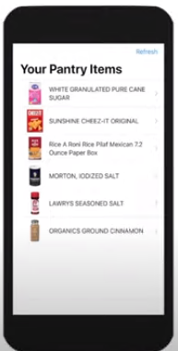
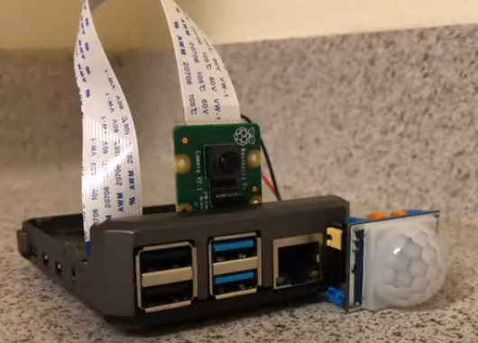
Electrical Engineering- The Smart Pantry App
Smart system that utilizes machine learning to do automated inventory tracking for your home pantry.
The experience in doing this project was challenging but also exciting and enriching.
We were able to learn about new technologies over the course of the project and actually be successful in applying them to our project.
One of the biggest challenges was trying to figure out how to make changes to our design and improve on our mistakes.
By Trejon Adams and Christopher Stevenson
Notes:
This is an example of an Electrical Engineering senior capstone project. This team of EE students designed an automated inventory tracking system for your home pantry.

Slide 17
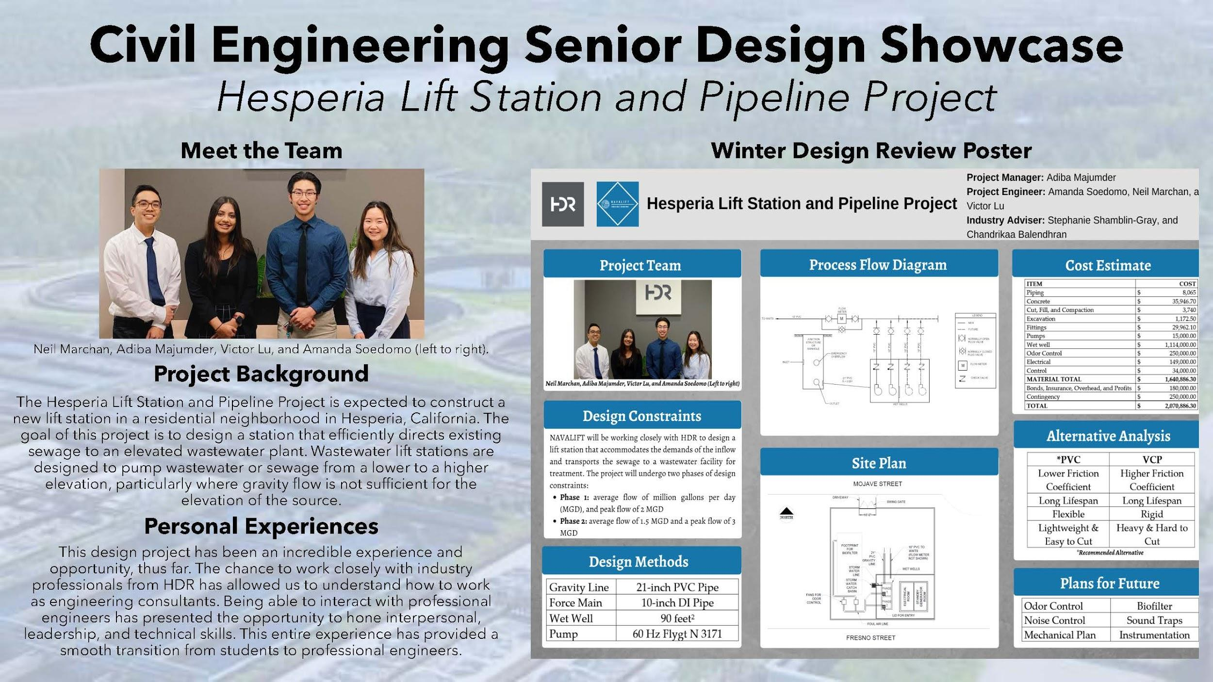
Notes:
This group of Civil Engineering students designed a new lift station to pump sewage from a lower elevation to a higher elevation.

Slide 18
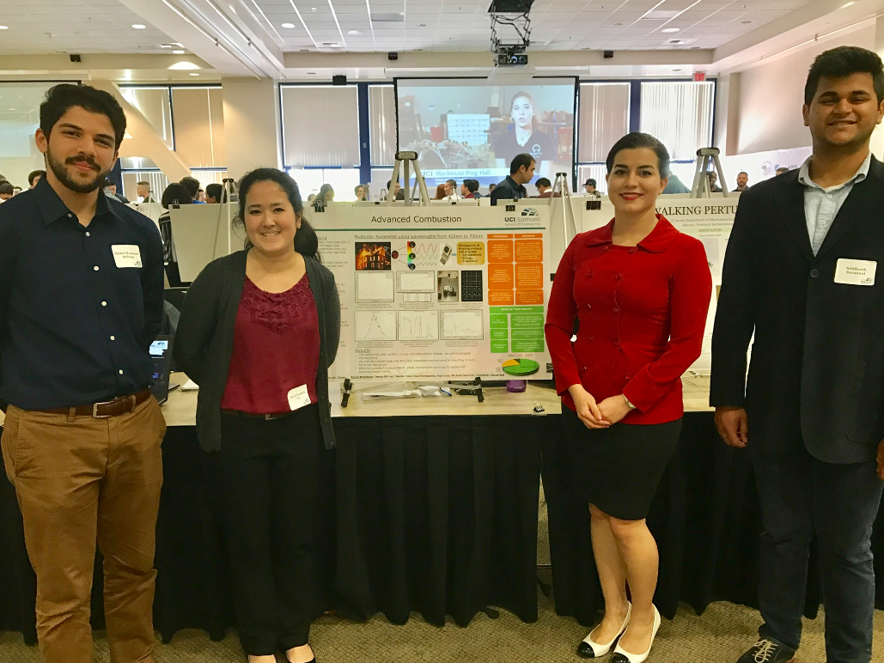
Student Research Opportunities
Independent study (199)
  Units
  Letter grade
  Apply to degree requirements
Undergraduate Research Opportunity
Program (UROP)
  Faculty mentor
  Proposal writing
  Thesis
  Symposium
Notes:
Students can get involved with research both informally by enrolling into a course which can provide degree credit and formally through our Undergraduate Research Opportunities Program.

Slide 19
Research Opportunities
UCI is home to or affiliated with more than a dozen research centers and experimental facilities
Advanced Power and Energy Program (APEP)
The Edwards Lifesciences Center for Advanced Cardiovascular Technology
FabWorks
Irvine Materials Research Institute
National Fuel Cell Research Center (NFCRC)
RapidTech
60 Companies, 3000 employees Nationally prominent firms
Blizzard Entertainment
Broadcom
Canon
Cisco Systems
Intel Corporation
Skywork Solutions
Numerous start-up companies
Notes:
UCI is home to several research centers and experimental facilities. Also, we are located right next to University Research park with 60 companies and opportunities for research and internships!

Slide 20
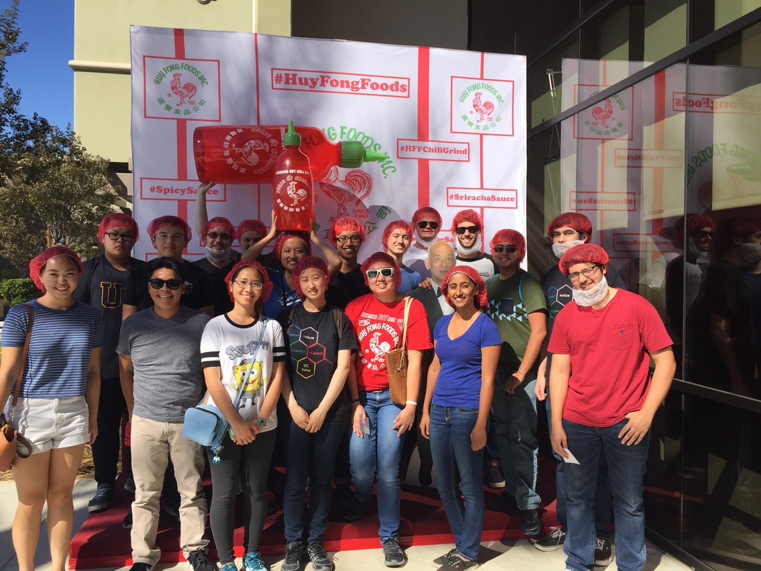




CONNECT WITH INDUSTRY
Handshake – job/internship search
Internship Fairs every quarter
STEM Career Fair – October
Engineering Tech Fair – February
Notes:
Through our numerous career fairs, students are able to connect with industry to secure internships and to network during their time at UCI. Several of our engineering student organizations attend conferences which also allow for networking with national chapters and industry.
We offer various career fairs throughout the academic year to allow for these connections to that place and encourage students to participate as early as freshman year.

Slide 21
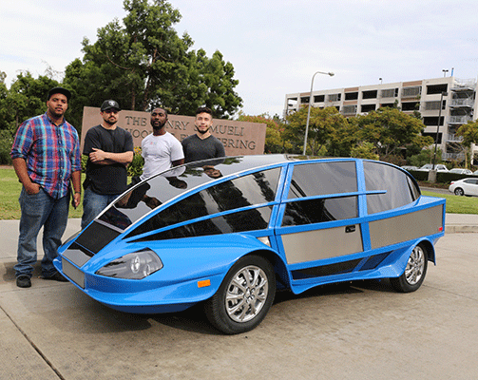
OFFICE OF ACCESS AND INCLUSION
Two week Summer transition program
Academic support
Mentoring program
Academic and career skills workshops
Internship and job shadowing opportunities
Industry and alumni networking socials
Notes:
The office provides Academic support programs. Such as the two-week summer transition program that helps to ease the transition from high school to UCI by providing an opportunity to become familiar with UCI and all its resources.
The program will help emphasize leadership, study skills and time management.
Throughout the academic year the office of access and inclusion also provides
· Academic support
· Mentoring programs
· Academic and career skills workshops
· Internship and job shadowing opportunities
· Industry and alumni networking socials -which feature- resume reviews, mock interviews and Q and A’s from industry professionals.

Slide 22
UCI Engineering by the Numbers
3977 undergraduates
25% women
36% first generation
25% low-income
Time to degree FR-- 4 yrs + 1 quarter
Time to degree TR -- varies by major
Spring 2019 graduates -- 632
Summer 2019 graduates -- 87
Ranked 22nd in public university engineering programs
⅔ of students participate in faculty-led research
6 departments, 11 majors

Slide 23
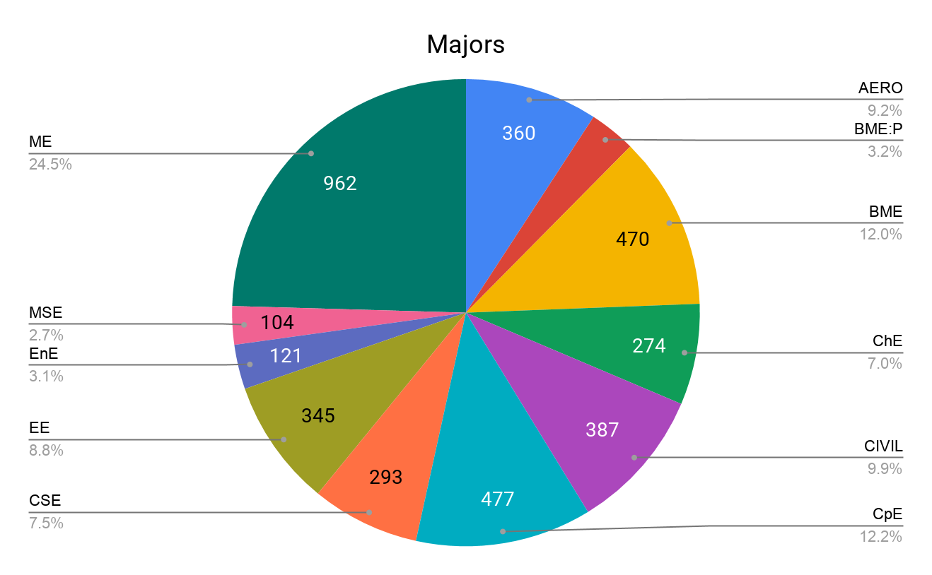
Notes:
We have 11 majors in Engineering. As you can see, the largest major is Mechanical Engineering, followed by Computer Engineering. Materials science and Engineering is our smallest major however being our newest department it is steadily growing.

Slide 24




Connect with us!
ZotChat: undergraduate.eng.uci.edu/
Ambassadors: engambassadorsuci@gmail.com
Instagram: @engroffice
Facebook: facebook.com/ugengr/
Twitter: @UCIEngineering
Notes:
CONNECT WITH US! Use these platforms to reach out to us for any questions you may have and stay up to date with our office!

Slide 25

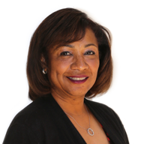
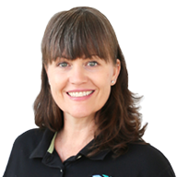
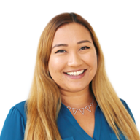

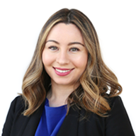

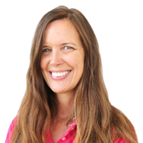
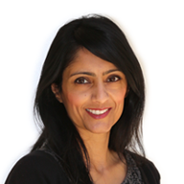
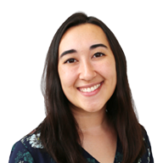
Thank you for your interest in UCI and the Samueli School of Engineering! You can contact us at ugengr@uci.edu!
Michael Green Robin Jeffers Christy King Maggie Anderson Cesar Barrios
Erica Juarez John Kaufman Mitzi Orme Ushma Patel Andrea Varon
Notes:
Thank you for your interest in UCI! Please feel free to reach out to us should you have any questions! We hope we will get a chance to work with you during your academic career and wish you the very best in your future endeavors!

Slide 26
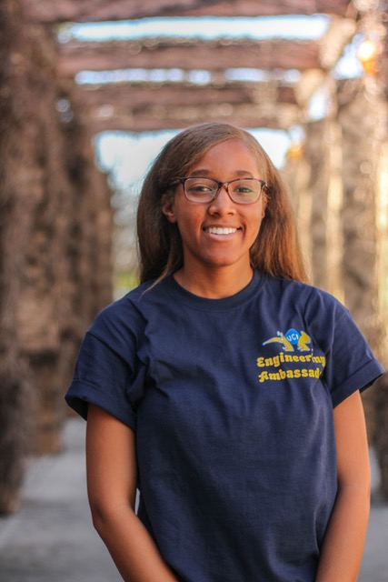
Student Spotlight
Congrats on being admitted to our Samueli School of Engineering! As you begin on your academic journey, remember to have fun and make the most of your college years. Take advantage of the many opportunities and resources available on campus. Get to know as many people as you can because developing a network is the best compliment to your knowledge. It will not be an easy journey, but it will all be worth it!
Kamry Hearns
B.S. Chemical Engineering 2021
Engineering Ambassador

Slide 27
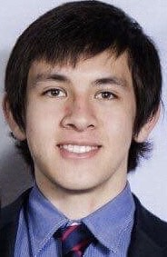
Student Spotlight
Why I chose UCI:
Study Biomedical Engineering which many universities do not have and especially because there are tissue engineering and genomics engineering courses. Also, UCI is local to a hot bed of biotech companies. I met Prof Choi before committing and loved his enthusiasm for Biomedical Engineering.
My favorite thing about UCI:
Learned lots about myself as a person and how to communicate effectively
1 piece of advice:
Engineering Counselors are amazing at helping you plan your curriculum. Plan early and meet often.
Christopher Glaubensklee
B.S. Biomedical Engineering 2020
Engineering Ambassador

Slide 28
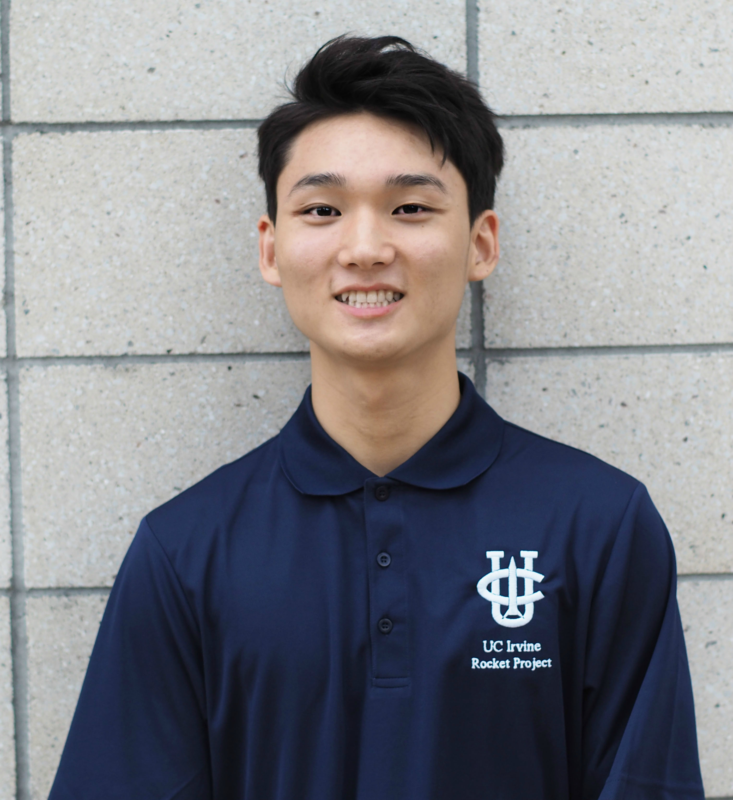
Student Spotlight
Welcome Future UCI Students!
Congratulations on your acceptance to University of California, Irvine! We are excited to have you as a part of our community and cannot wait to see what potential you can bring to the campus. To every student who is looking forward to their first step in experiencing college life in UCI, you will truly enjoy the balance of academic life and extracurricular activities the school offers that highly promotes a healthy, competitive lifestyle for all students. In addition, the city of Irvine is one of the safest and cleanest cities in America and it’s located in the center of many large companies in Southern California! We want to congratulate you once again for all the hard work and accomplishments you made to earn your acceptance in UCI. Welcome Anteaters!
With Best Regards,
Edward Lee
B.S. Mechanical Engineering 2022
Engineering Ambassador

Slide 29
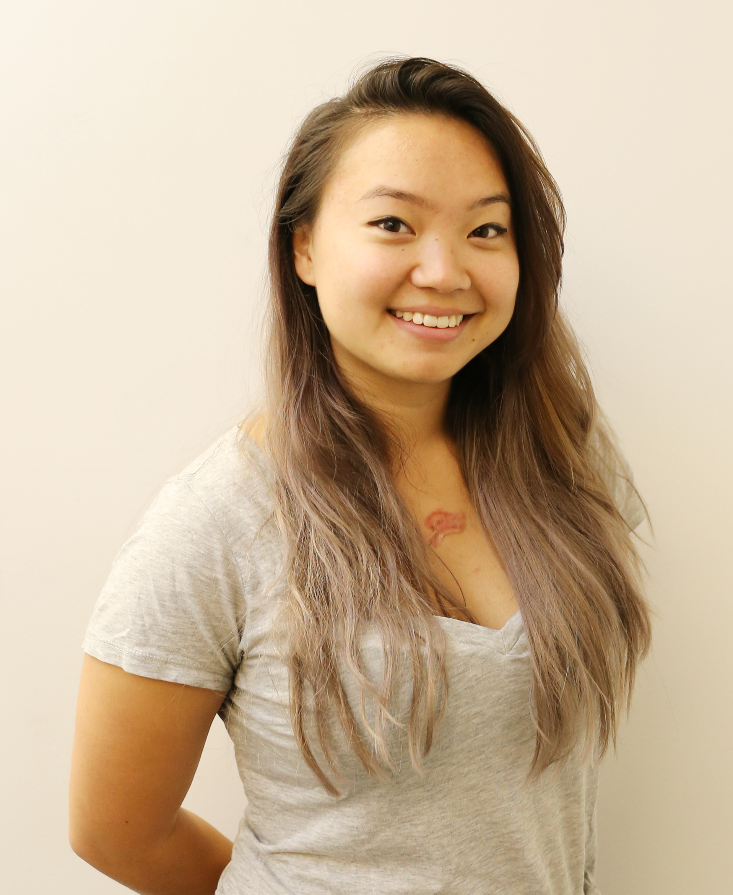
Student Spotlight
To be completely honest, I wasn’t very excited to go to UCI for college. However, once I got to campus, it didn’t take very long for me to fall in love with this school. I love that the curriculum in biomedical engineering along with the other engineering majors emphasizes the importance of collaboration with at least one group project to complete each quarter. This gave me a chance to practice my technical skills by applying engineering principles, but also develop my soft skills by learning how to work well with others, which is extremely important in the engineering industry.
Along with this, UCI offers so many opportunities in research, extracurricular activities, and career development. One piece of advice I would give is to take full advantage of the resources offered on campus. Having worked as a Peer Academic Advisor, having done research for three years, joined various clubs and organizations, and utilized resources such as the Career Center and the Student Wellness & Health Promotion, I can honestly say my time at UCI has been full of opportunity. I have grown so much these past five years and because of that, I am extremely grateful for UCI.
Sophia Ynami
B.S. Biomedical Engineering, B.A. Urban Studies
Peer Academic Advisor

Slide 30
We wish you the best of luck in all your future endeavors and hope to see you in the fall!
Engineering Undergraduate Student Affairs
Questions: please email us at ugengr@uci.edu

